Slide 1
BIODIVERSITY PROJECT
Analysis of data from the National Parks Service about endangered species in different parks.
Created by Olga Skripnichenko

Slide 2
GOALS AND STRUCTURE OF THE PROJECT
The main objectives are:
Perform data analysis on the conservation statuses of species;
Investigate if there are any patterns or themes to the types of species that become endangered;
Identify and provide information to the National Park Service that can be useful for the conservation of biodiversity.
A list of visualizations:
brief description of data;
species composition according to their categories;
species composition according to their statuses;
how species are distributed by status in each category;
distribution of the number of observations;
observation boxplots for each park;
How to identify species that are at risk of changing their status to a more dangerous one.

Slide 3
DISCRIPTION OF DATA
Data sources
species_info.csv
category - class of animal
scientific_name - the scientific name of each species
common_name - the common names of each species
conservation_status - each species current conservation status
observations.csv
scientific_name - the scientific name of each species
park_name - the name of the park in which this species was observed
observations - the number of observations in the past 7 days
Short dataframe review:
Number of species: 5541
Parks: ['Bryce National Park' 'Great Smoky Mountains National Park' 'Yellowstone National Park' 'Yosemite National Park’]
Number of observations: 3154261.0
Categories: ['Vascular Plant' 'Nonvascular Plant' 'Bird' 'Amphibian' 'Reptile' 'Mammal' 'Fish’]
Statuses: ['1 - Not Evaluated' '2 - Species of Concern' '3 - Threatened' '5 - In Recovery' '4 - Endangered']

Slide 4
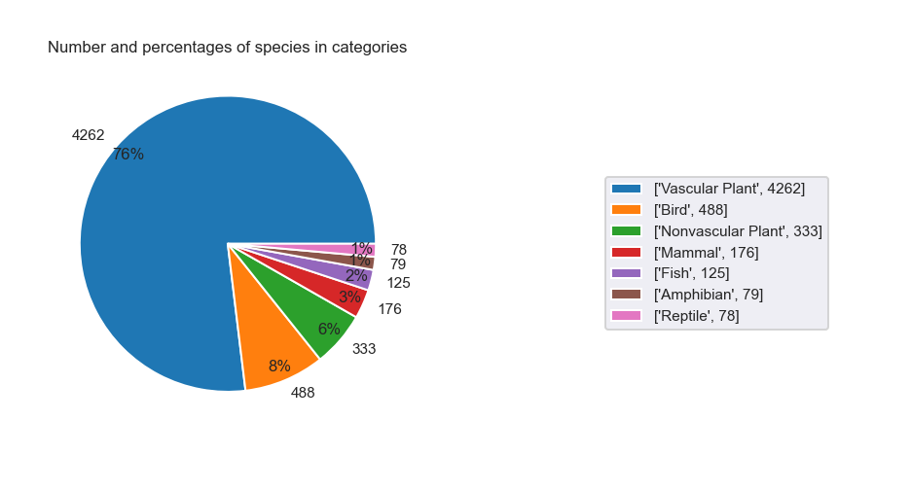
Species composition according to their categories

Slide 5
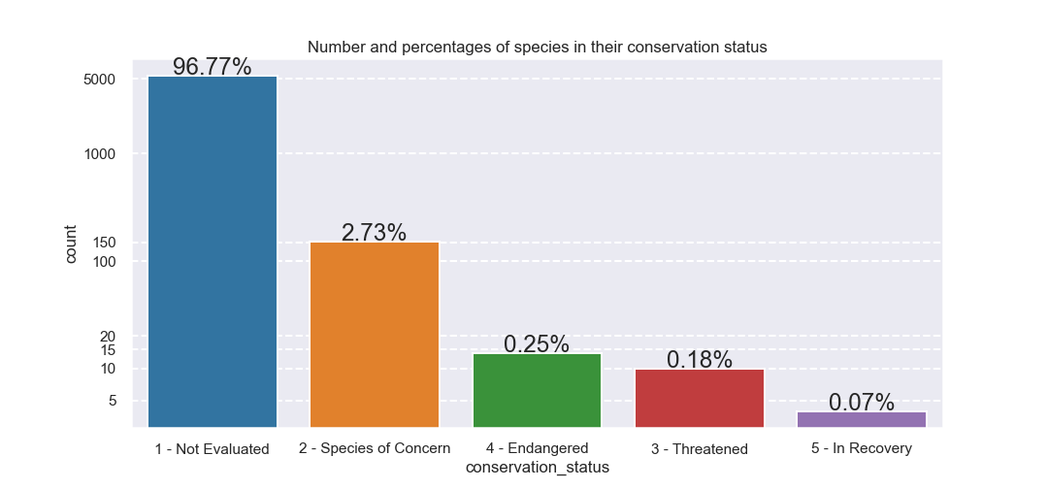
Species composition according to their statuses

Slide 6
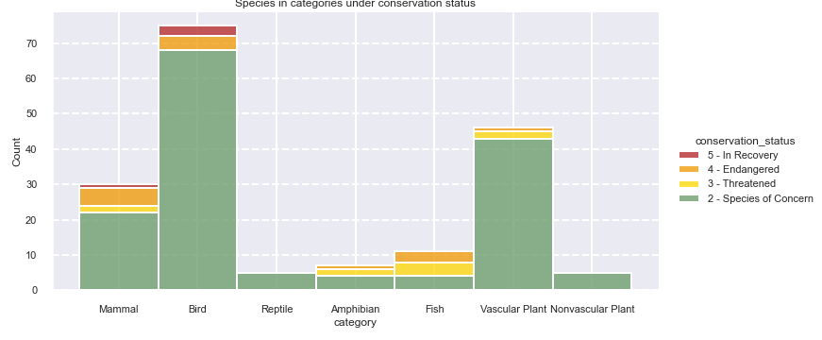
How species are distributed by status in each category

Slide 7
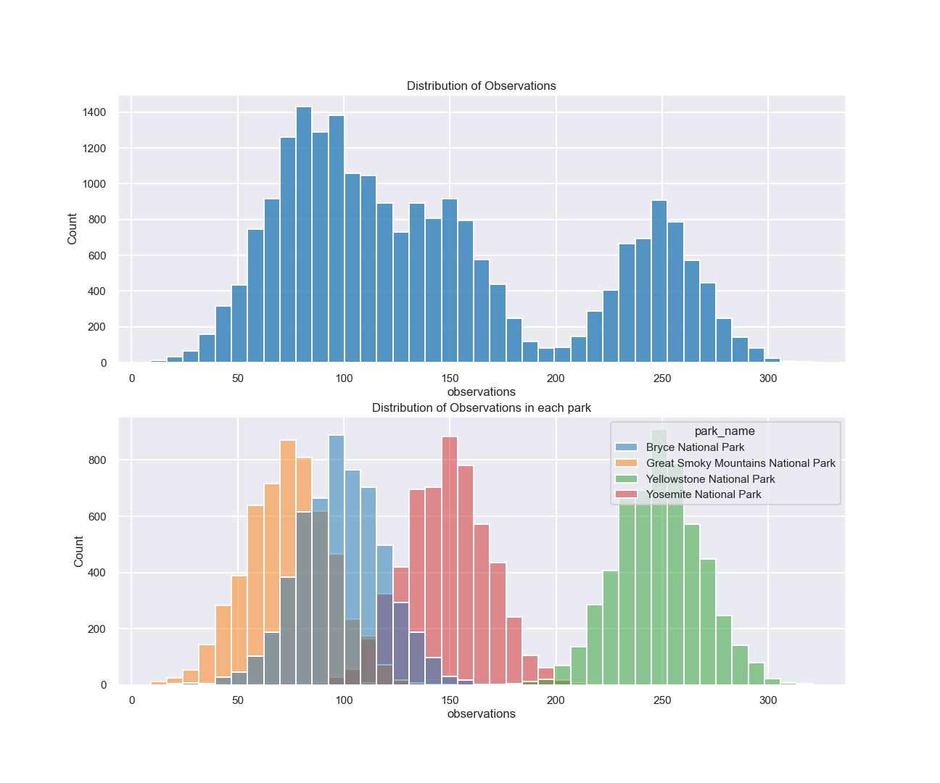
Distribution of the number of observations
The position of each distribution of observations relative to others is determined by the number of observations.
We see that Yellowstone National Park has more observations than others. This difference in the number of observations due to the size of the parks (Yellowstone is the largest).
Further we will look at the distribution of observations for each park separately.

Slide 8
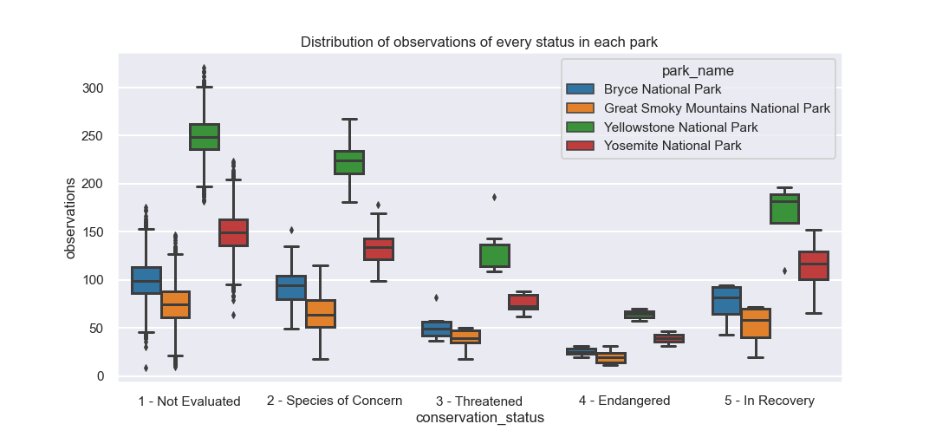
Observation boxplots for each park

Slide 9
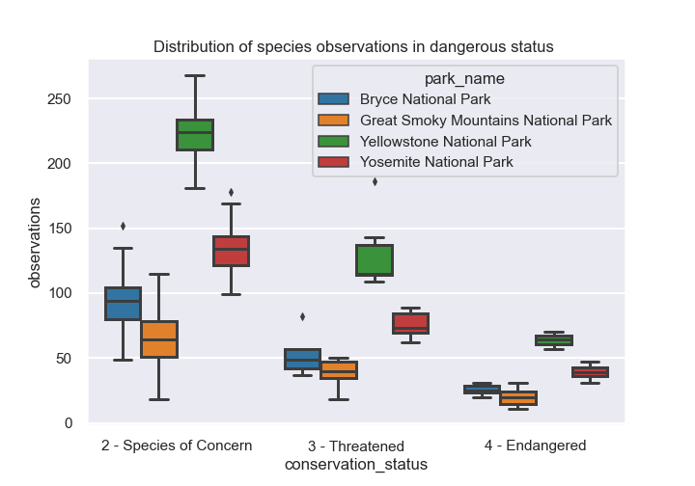
How to identify species that are at risk of changing their status to a more dangerous one
Find those varieties whose observations are much lower than the values for the group, or rather fall into the IQR of the group of the more dangerous status.
We will consider only statuses: Species of Concern, Threatened, Endangered.

Slide 10
Conclusions and further research
76% of all observed species are Vascular Plants. Others: Nonvascular Plants, Mammals, Birds, Fishes, Amphibians and Reptiles.
Approximately 97% of all species have not been assigned a conservation status. Only 179 species are protected (those with a conservation status).
Mammals and Birds are in a more dangerous state.
Observations in each park have normal distribution.
We noticed the dependence of the conservation status and the number of observations by constucting boxplots for each park. But the use of statistical testing for this data is not correct because the variance of the datasets is not equal.
After analyzing the data, we have compiled a list of those species to which each park should pay attention in order to prevent the transition of this species to a more dangerous status. These results can be viewed in the dictionary named dict_warning.
Since the distribution of observations is not normal, in the analysis we considered the data for each park separately. Given the data on the size of the parks, it will be possible to use the quantity: the number of observations per square meter, to bring data of all the parks together.
Many factors are taken into account when assessing conservation status, not simply the number of individuals remaining. So further research requires data on population change over time.

